Slide 1




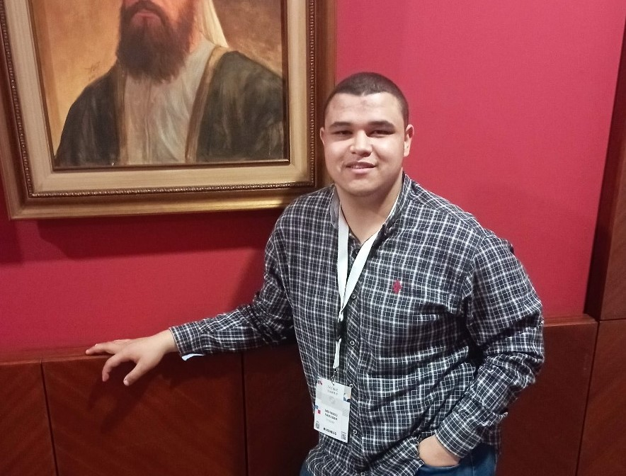
ITI Examination System
Reham Essam
Ahmed Marzouk
Basma Bssem
Ali Omar
Mohammed Ramadan

Slide 2
Table of contents
01
02
03
04
05
06
ERD & Mapping
Database Creation
Main Stored Procedures
SSRS
Power BI Dashboards
SSIS
07
Application

Slide 3

01
ERD & Mapping

Slide 4
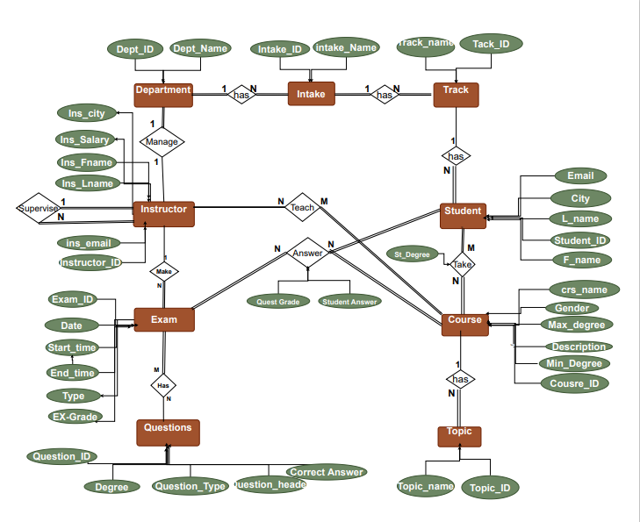
ERD

Slide 5
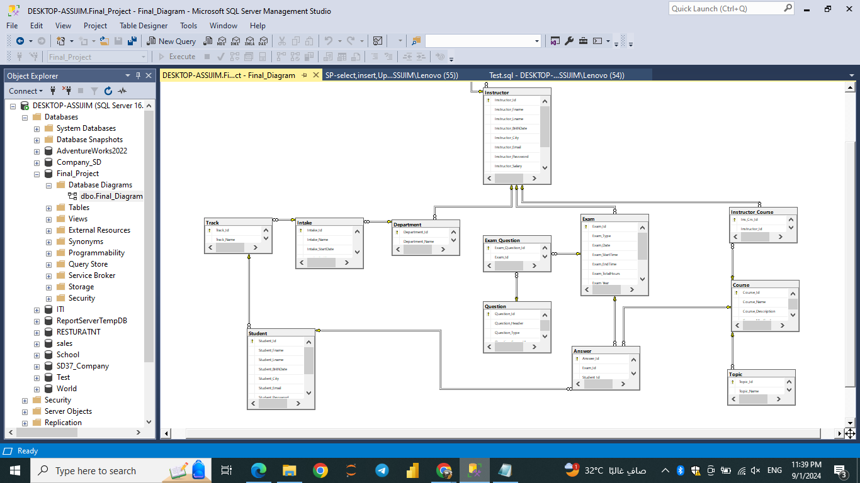
Mapping

Slide 6

02
Database Creation

Slide 7
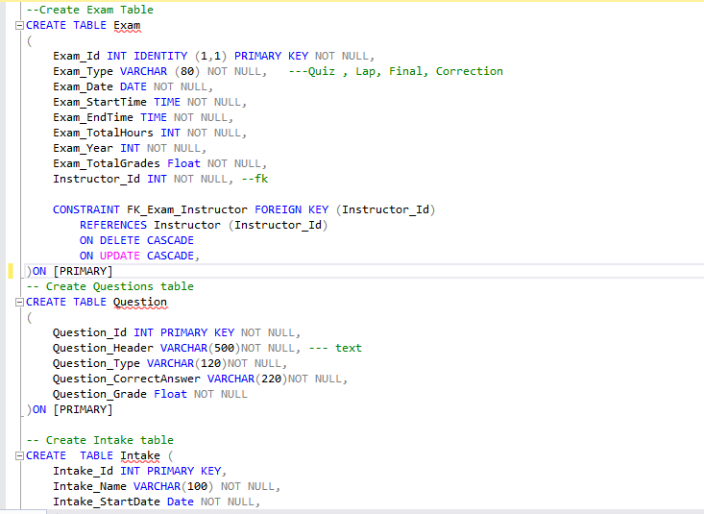
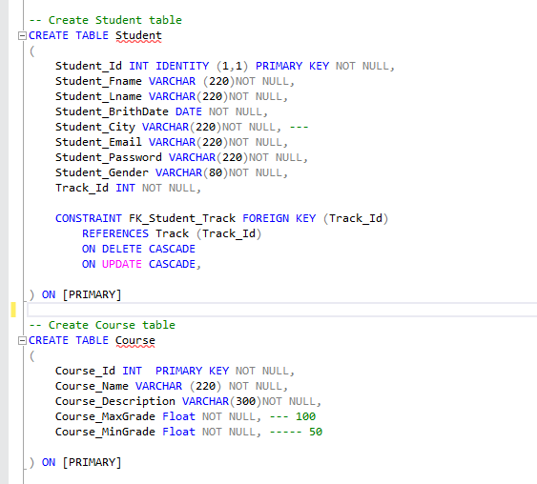
Examples of Create Tables

Slide 8
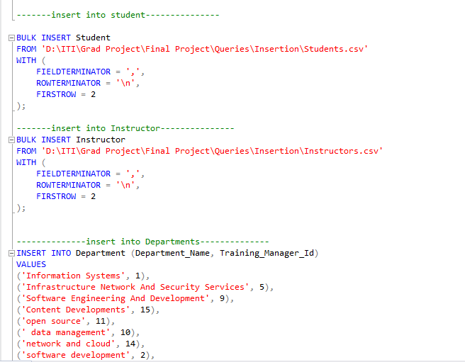
Examples of Insert Data From Csv files

Slide 9
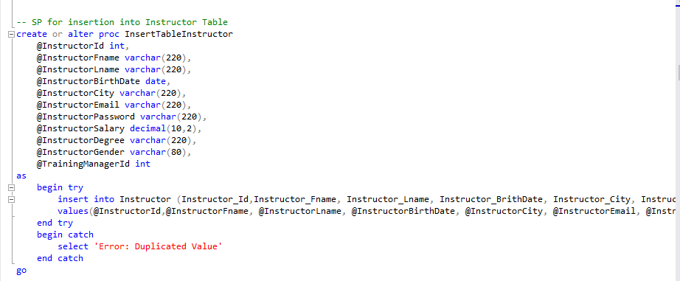
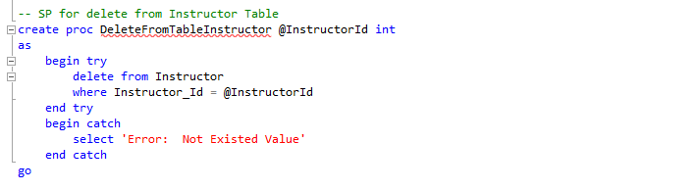
Examples of Select, Insert , Update, Delete Stored Procedure

Slide 10
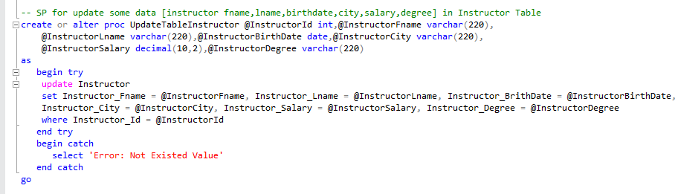
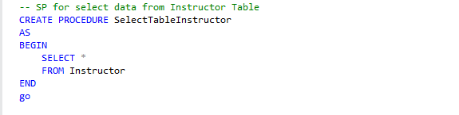
Examples of Select, Insert , Update, Delete Stored Procedure

Slide 11

03
Main Stored Procedures

Slide 12
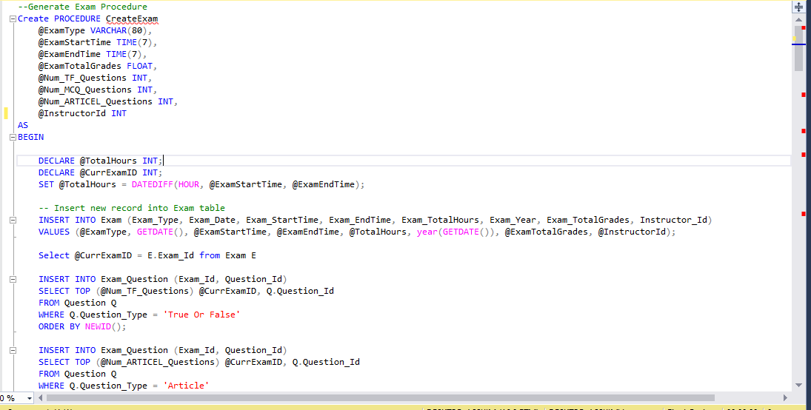
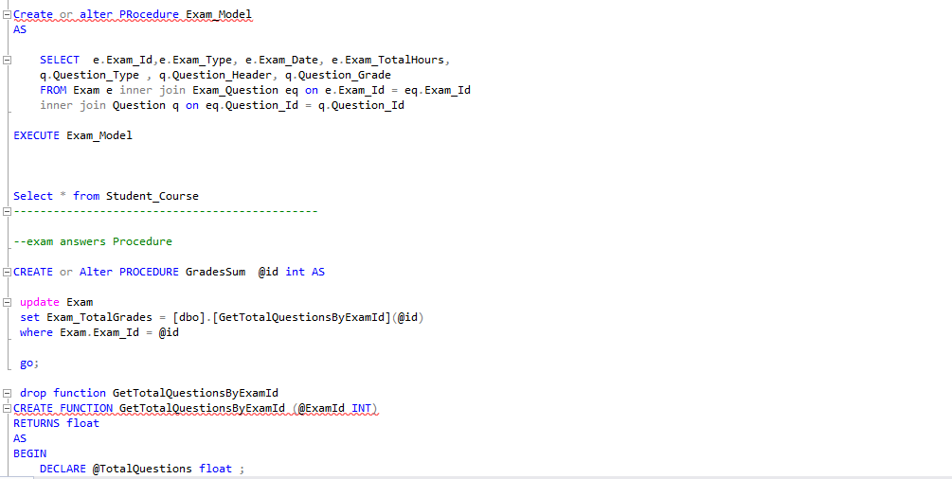
Examples of 3 Main Stored Procedure

Slide 13

04
SSRS Reports

Slide 14
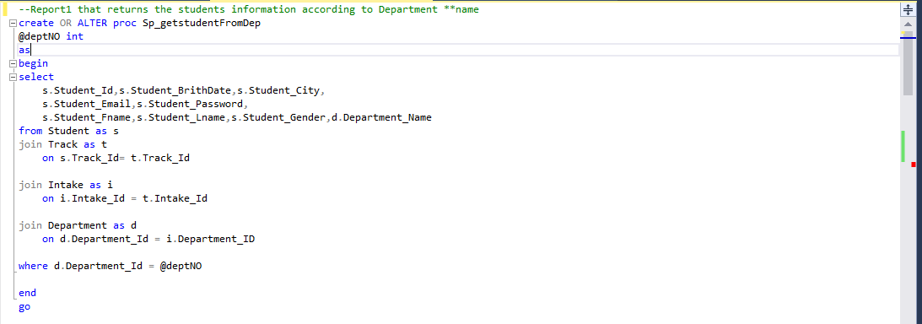
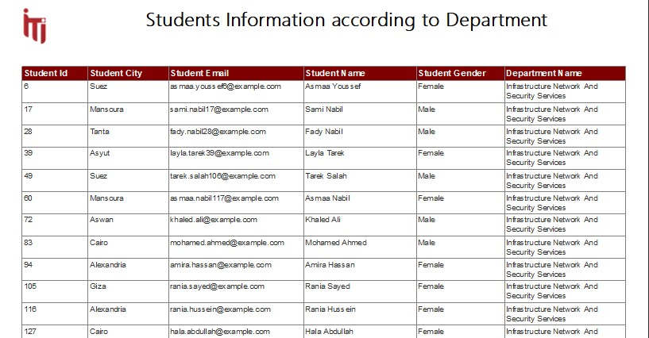
SSRS Reports

Slide 15
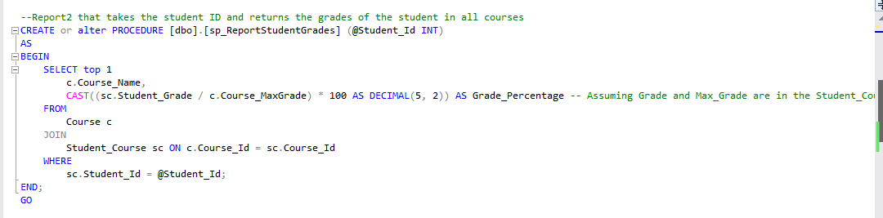

SSRS Reports

Slide 16
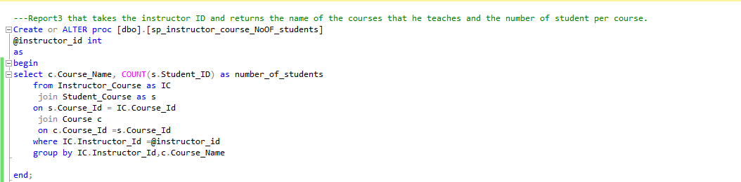
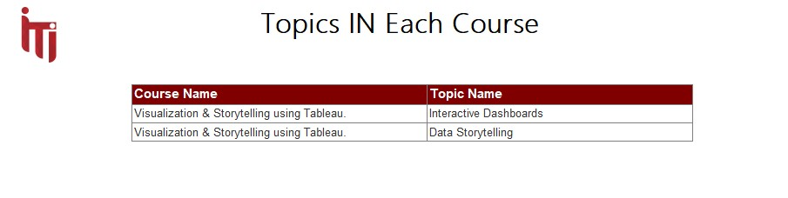
SSRS Reports

Slide 17
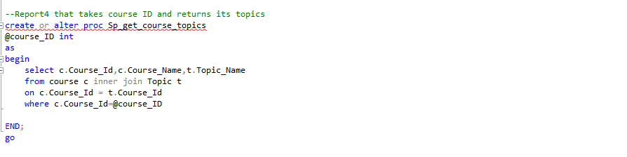
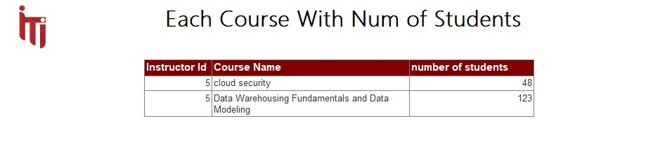
SSRS Reports

Slide 18
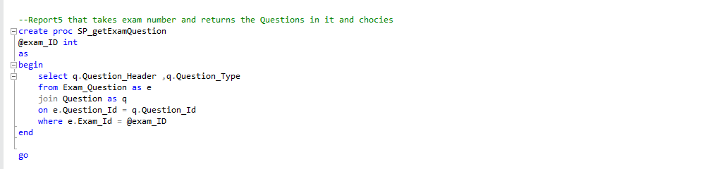
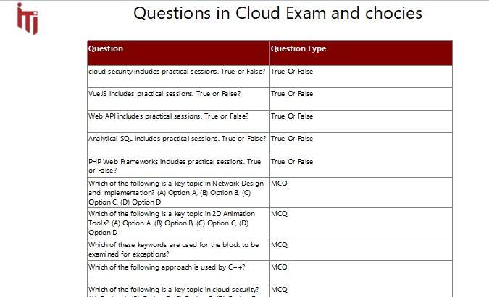
SSRS Reports

Slide 19
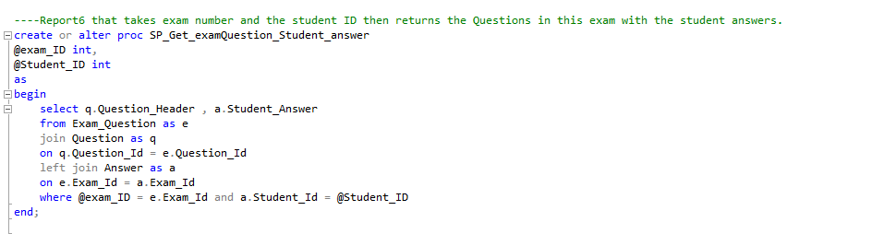
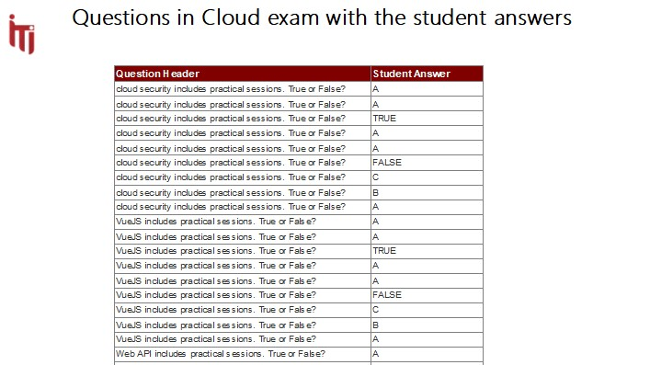
SSRS Reports

Slide 20

05
Power BI Dashboards

Slide 21
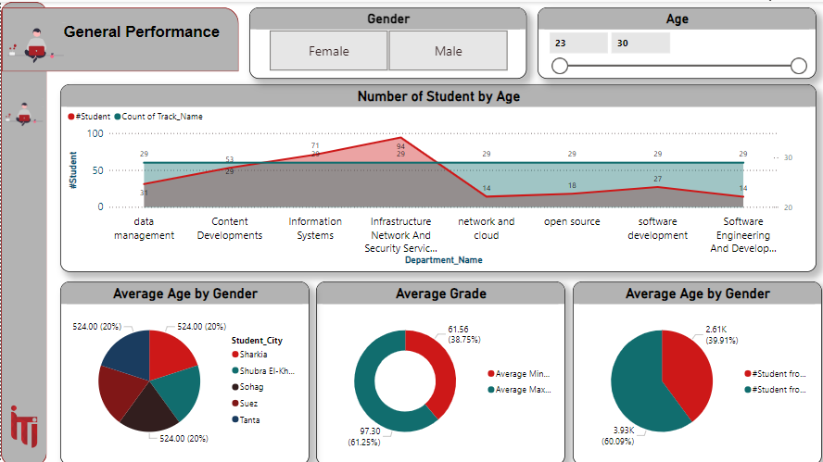
Example of Power BI Dashboards

Slide 22
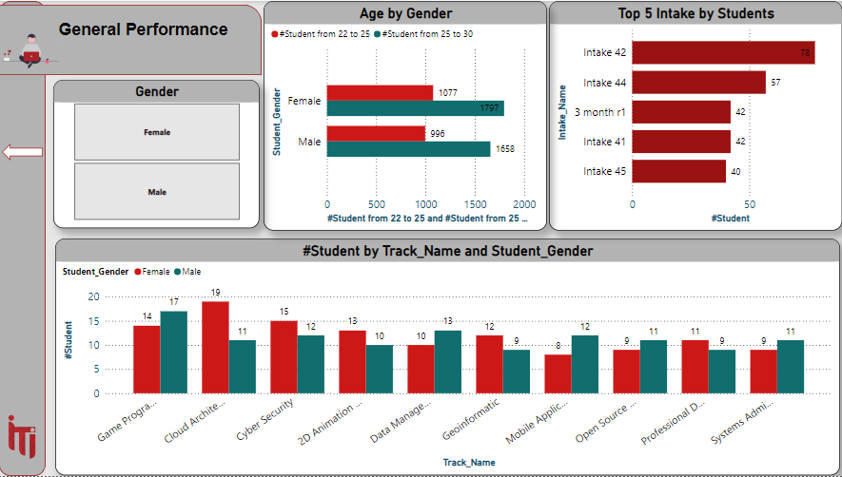
Example of Power BI Dashboards

Slide 23
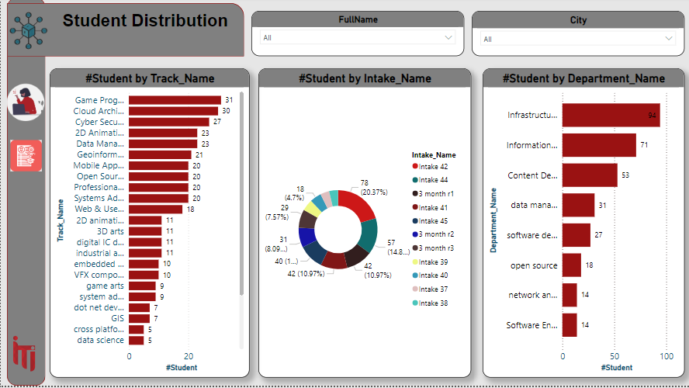
Example of Power BI Dashboards

Slide 24
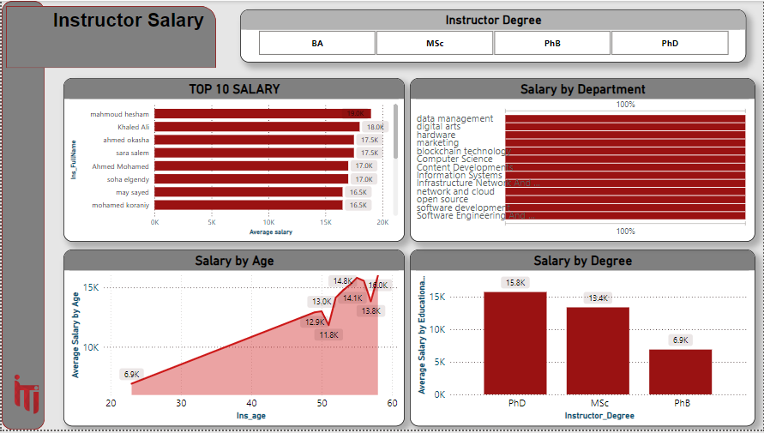
Example of Power BI Dashboards

Slide 25
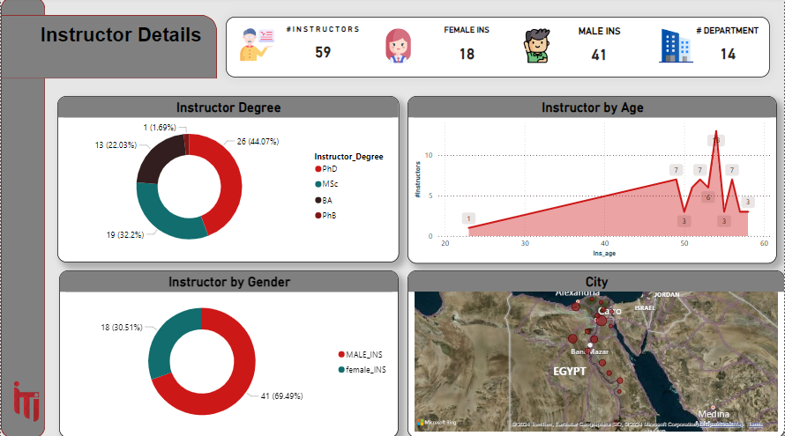
Example of Power BI Dashboards

Slide 26
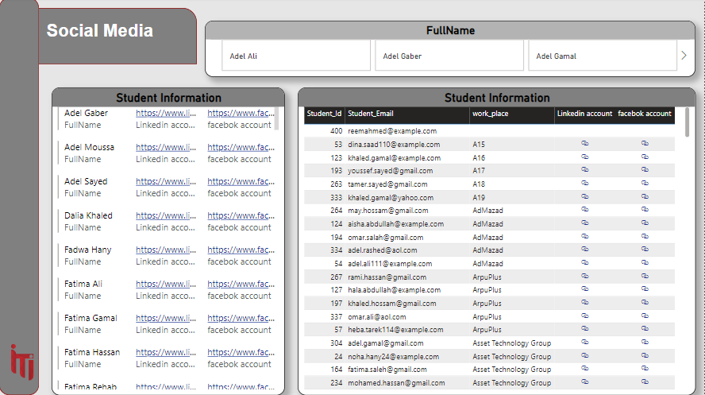
Example of Power BI Dashboards

Slide 27

06
SSIS

Slide 28
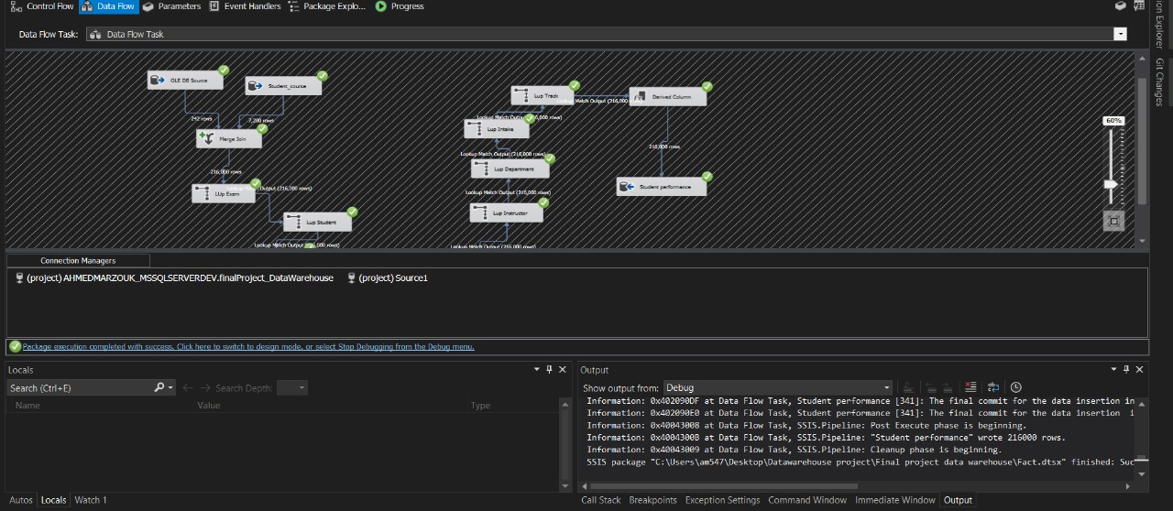
Example of SSIS

Slide 29
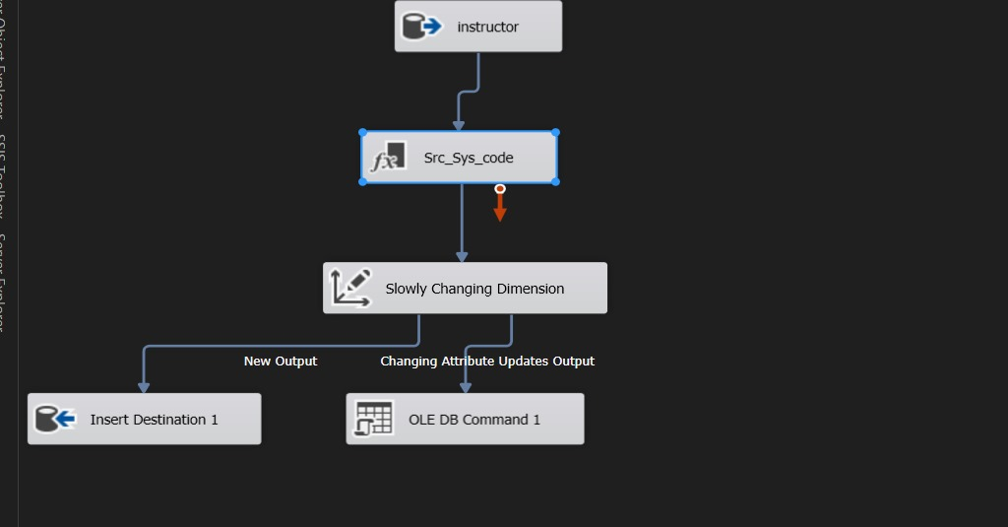
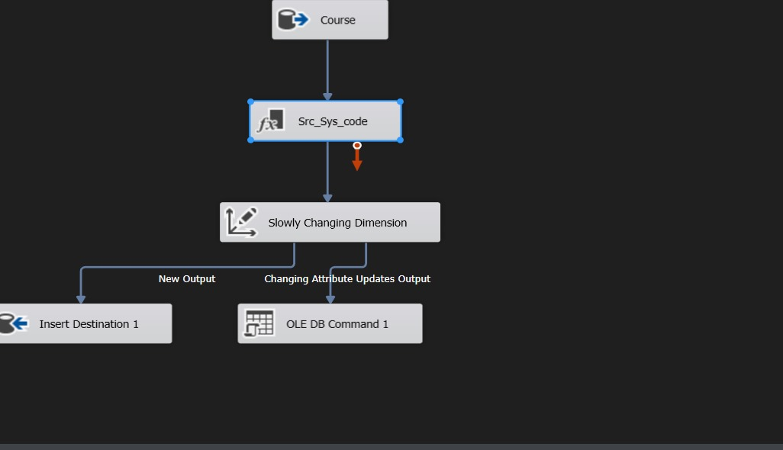
Example of SSIS

Slide 30

07
Application

Slide 31
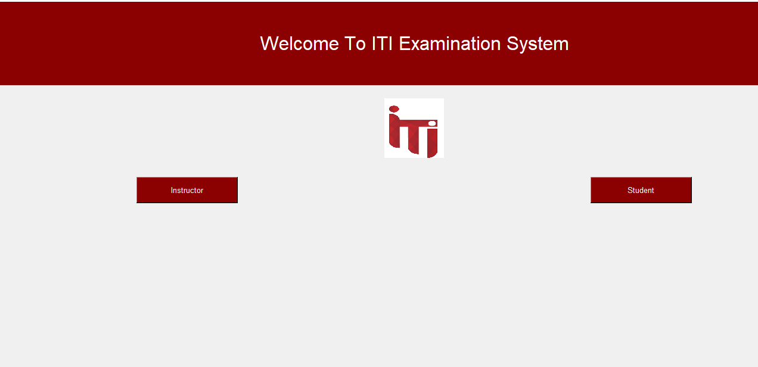
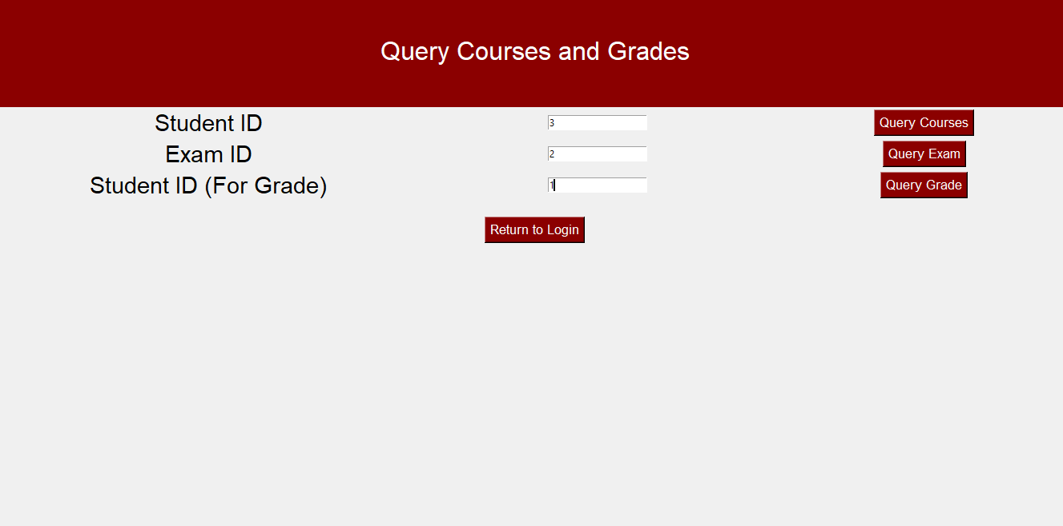
Application

Slide 32
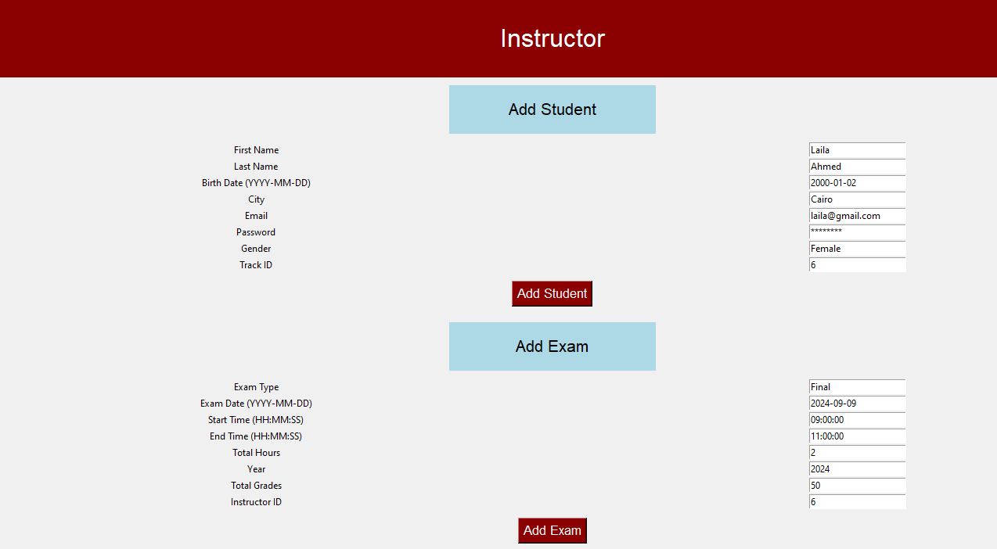
Application

Slide 33









Tools and Technologies Used
Used For Design ERD
Used For Host Database ,Queries
Build and Design Dashboards
Prepare GP Document
Create Desktop App
Create SSRS Create SSIS
Team Meetings
Organize Tasks
Team Connection

Slide 34

Thanks!
Do you have any questions?

